Slide 1
Report Week 11
SCHOOL OF MECHANICAL AND AEROSPACE ENGINEERING
Doan Manh Hung
Oct 31th, 2014

Slide 2
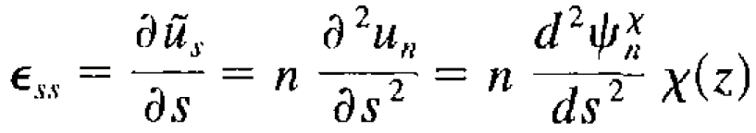
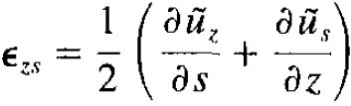
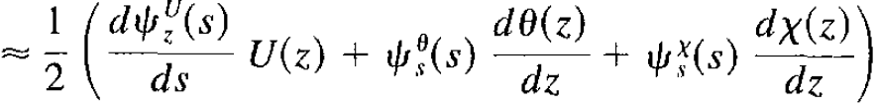

Distortion function for trapezoidal cross section
$U_{z}\left(s,z\right)={{ψ_{z}}^{θ}}_{(s)}$.$θ_{(z)}+{{ψ_{z}}^{U}}_{(s)}$.$U_{(z)}+{{ψ_{z}}^{𝒳}}_{(s)}$.$𝒳_{(z)}$
$\tilde{U_{z}}={ψ_{z}}^{U}.U$
Have
$ε_{zz}=\frac{δ\tilde{U_{z}}}{δz}={ψ_{z}}^{U}.\frac{δU_{z}}{δz}$
The nonzero stress components by warping:
${σ_{zz}}^{U}=E_{1}\left(ε_{zz}+v.ε_{ss}\right)=E_{1}.\frac{δU_{z}}{δz}=E_{1}.{ψ_{z}}^{U}.\frac{δU_{z}}{δz}$
${σ_{zs}}^{U}=2G.ε_{sz}=G.\frac{δ{ψ_{z}}^{U}}{δs}.U_{z}$
a
α
h
b

Slide 3
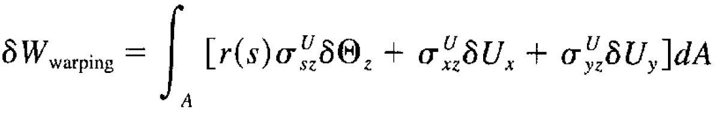
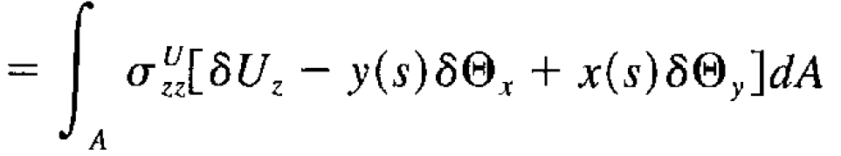


Warping function for trapezoidal cross section
Warping deformations generally result from flexural and torsional deformation:
No virtual work be done by warping stress due to the rigid-body motions associated with axial extensional and bending motion:

Slide 4
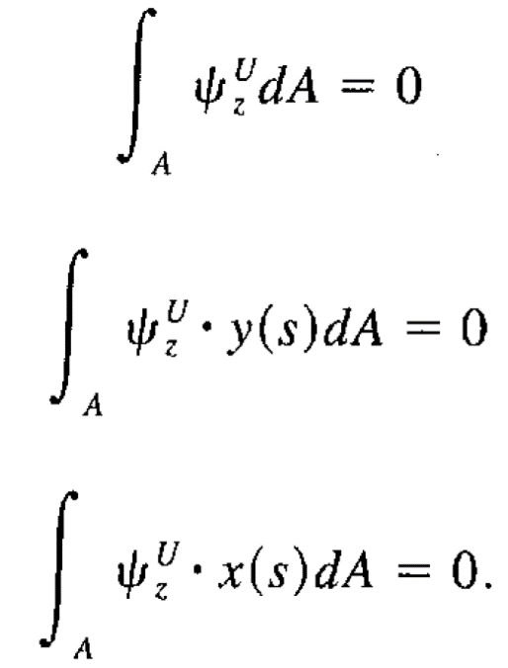
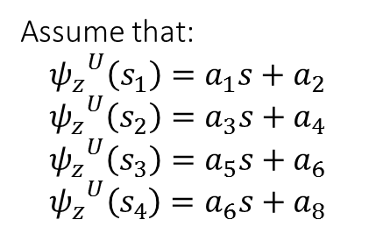
Warping function for trapezoidal cross section
(1)
(2)
(3)
a
α
S2
S1
h
S3
Assume that:
$${ψ_{z}}^{U}\left(s_{1}\right)=a_{1}s+a_{2}$$
$${ψ_{z}}^{U}\left(s_{2}\right)=a_{3}s+a_{4}$$
$${ψ_{z}}^{U}\left(s_{3}\right)=a_{5}s+a_{6}$$
$${ψ_{z}}^{U}\left(s_{4}\right)=a_{6}s+a_{8}$$
S4
b

Slide 5
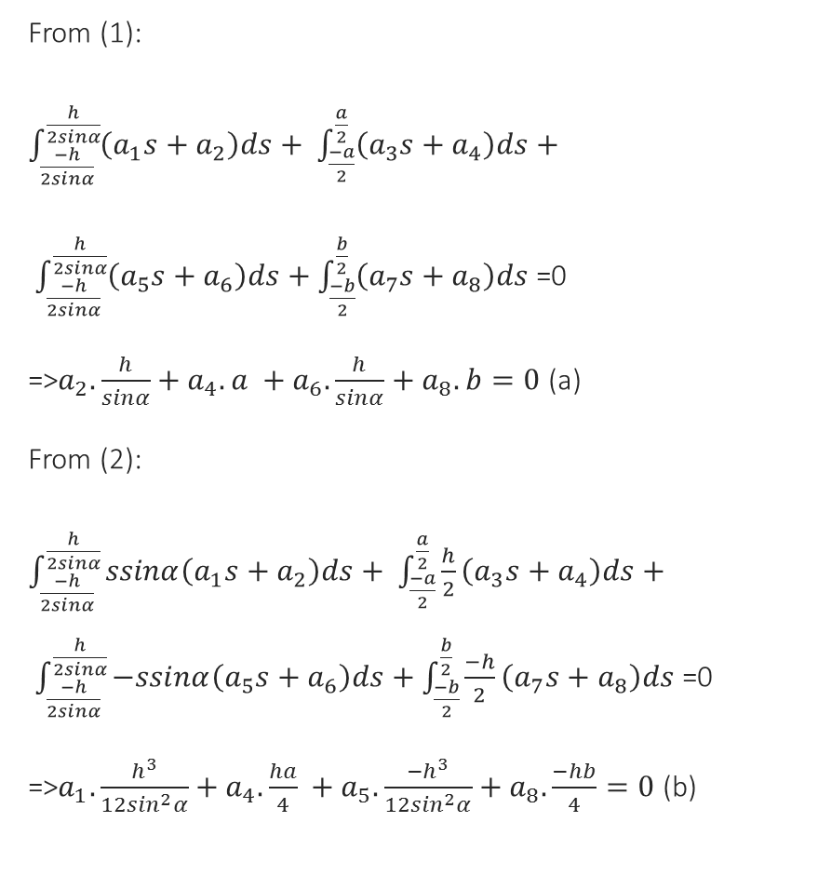
Warping function for trapezoidal cross section
From (1):
$\int_{\frac{−h}{2sinα}}^{\frac{h}{2sinα}}{\left(a_{1}s+a_{2}\right)ds}+ \int_{\frac{−a}{2}}^{\frac{a}{2}}{\left(a_{3}s+a_{4}\right)ds}+$
$\int_{\frac{−h}{2sinα}}^{\frac{h}{2sinα}}{\left(a_{5}s+a_{6}\right)ds}+\int_{\frac{−b}{2}}^{\frac{b}{2}}{\left(a_{7}s+a_{8}\right)ds}$ =0
=>$a_{2}.\frac{h}{sinα}+a_{4}.a +a_{6}.\frac{h}{sinα}+a_{8}.b=0$ (a)
From (2):
$\int_{\frac{−h}{2sinα}}^{\frac{h}{2sinα}}{ssinα\left(a_{1}s+a_{2}\right)ds}+ \int_{\frac{−a}{2}}^{\frac{a}{2}}{\frac{h}{2}\left(a_{3}s+a_{4}\right)ds}+ \int_{\frac{−h}{2sinα}}^{\frac{h}{2sinα}}{−ssinα\left(a_{5}s+a_{6}\right)ds}+\int_{\frac{−b}{2}}^{\frac{b}{2}}{\frac{−h}{2}\left(a_{7}s+a_{8}\right)ds}$ =0
=>$a_{1}.\frac{h^{3}}{12\sin^{2}α}+a_{4}. \frac{ha}{4} +a_{5}.\frac{{−h}^{3}}{12\sin^{2}α}+a_{8}. \frac{−hb}{4}=0$ (b)
a
S2
α
S1
h
S3
S4
b

Slide 6

Warping function for trapezoidal cross section
a
α
S2
From (3):
$\int_{\frac{−h}{2sinα}}^{\frac{h}{2sinα}}{(scosα+\frac{a+b}{2})\left(a_{1}s+a_{2}\right)ds}+ \int_{\frac{−a}{2}}^{\frac{a}{2}}{−s\left(a_{3}s+a_{4}\right)ds}+ \int_{\frac{−h}{2sinα}}^{\frac{h}{2sinα}}{(\frac{a+b}{2}scosα)\left(a_{5}s+a_{6}\right)ds}+\int_{\frac{−b}{2}}^{\frac{b}{2}}{s\left(a_{7}s+a_{8}\right)ds}=0$
=> $a_{1}.\frac{h^{3}cosα}{12\sin^{3}α}+a_{2}. \frac{h(a+b)}{2sinα}+a_{3}. \frac{−a^{3}}{4} +a_{5}.\frac{{−h}^{3}cosα}{12\sin^{3}α}+a_{6}. \frac{h(a+b)}{2sinα}+a_{7}. \frac{b^{3}}{12}=0 (c)$
S1
h
S3
S4
b

Slide 7
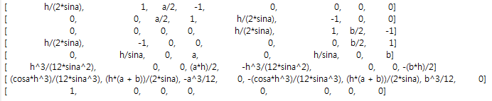
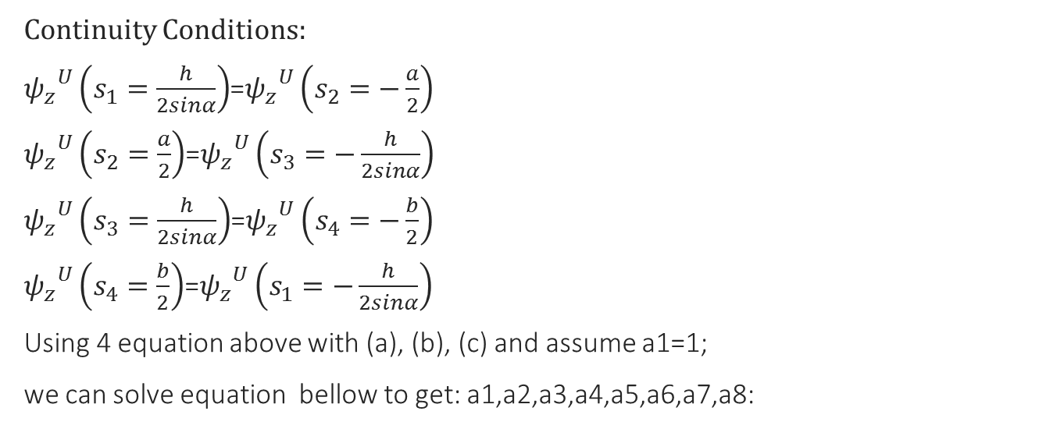
Warping function for trapezoidal cross section
Continuity Conditions:
${ψ_{z}}^{U}\left(s_{1}=\frac{h}{2sinα}\right)$=${ψ_{z}}^{U}\left(s_{2}=−\frac{a}{2}\right)$
${ψ_{z}}^{U}\left(s_{2}=\frac{a}{2}\right)$=${ψ_{z}}^{U}\left(s_{3}=−\frac{h}{2sinα}\right)$
${ψ_{z}}^{U}\left(s_{3}=\frac{h}{2sinα}\right)$=${ψ_{z}}^{U}\left(s_{4}=−\frac{b}{2}\right)$
${ψ_{z}}^{U}\left(s_{4}=\frac{b}{2}\right)$=${ψ_{z}}^{U}\left(s_{1}=−\frac{h}{2sinα}\right)$
Using 4 equation above with (a), (b), (c) and assume a1=1;
we can solve equation bellow to get: a1,a2,a3,a4,a5,a6,a7,a8:
a
α
h
b
. =

Slide 8
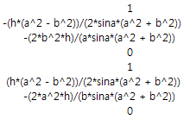

Warping function for trapezoidal cross section
Then:
And the warping shape functions:
${ψ_{z}}^{U}\left(s_{1}\right)=s+\frac{−h(a^{2}−b^{2})}{2sinα(a^{2}+b^{2})}$
${ψ_{z}}^{U}\left(s_{2}\right)=s.\frac{−hb^{2}}{asinα(a^{2}+b^{2})}$
${ψ_{z}}^{U}\left(s_{3}\right)=s+\frac{h(a^{2}−b^{2})}{2sinα(a^{2}+b^{2})}$
${ψ_{z}}^{U}\left(s_{4}\right)=s.\frac{−ha^{2}}{bsinα(a^{2}+b^{2})}$
a
=
α
h
b

Slide 9
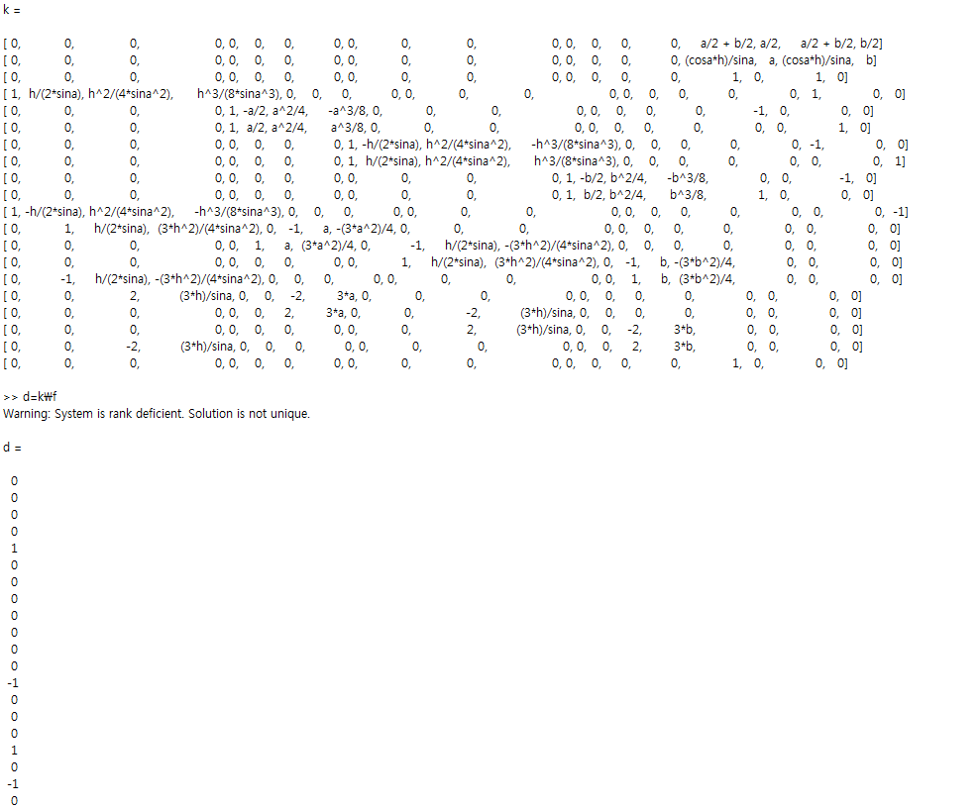
Distortion shape function

Slide 10
Going to do next week: - distortion shape functions

